Slide 1



Hardware and Software Fundamentals of Intelligent Computing Systems

Slide 2
Lecture 11: Flash Attention Implementation I (IO-Aware)
Notes:
模块二：Flash Attention I - IO 感知与分块计算核心目标： 解释“空间换时间”的哲学，重点在 Tiling 技术。封面： 速度之源——IO Aware（访存感知）的设计哲学。GPU 存储层级科普： HBM（显存）与 SRAM（高速缓存）的速度差（10倍级差距）。问题的根源： 标准 Attention 在 HBM 上的往返跑（Intermediate Matrices）。Flash Attention 核心思想： 不求快，但求“少动”。分块（Tiling）概念： 把大矩阵切成能塞进 SRAM 的小方块。动态演示 1： Q、K、V 的分块加载过程。内存访问对比图： 传统方式 vs. Flash Attention 的访存次数定量分析。Kernel Fusion： 解释如何将多个算子合并成一个 CUDA Kernel。SRAM 的调度艺术： 如何管理有限的缓存空间。前向传播的实现： 如何在不存储完整 $QK^T$ 的情况下计算结果。性能基准： 展示在 A100/H100 上的吞吐量提升。总结： IO 感知是现代深度学习算子优化的基石。

Slide 3
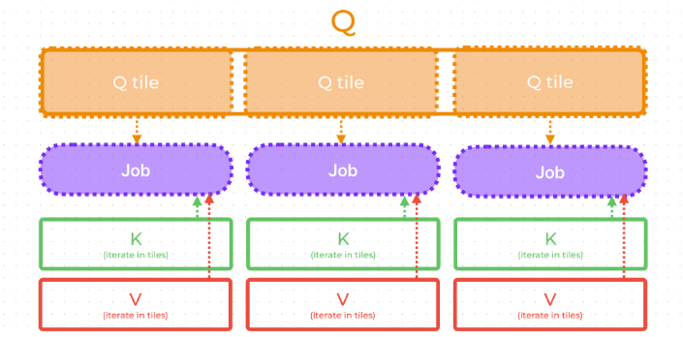
Flash Attention: Tiling Computation
Tiling: Breaking the large Q, K, V matrices into smaller blocks (Tiles) that fit entirely into SRAM, eliminating the need to store the massive intermediate Attention matrix.
Recomputation: Avoiding the storage of the S and P matrices during the forward pass; instead, re-calculating them during the backward pass to save memory.

Slide 4
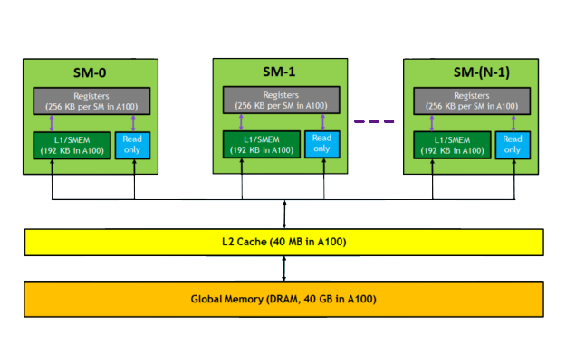
GPU Memory Hierarchy Explained
Speed Disparity: HBM vs. SRAM (10x Factor)
For example: A100
GPU Memory / HBM2e: 40/80 GB 1.5-2 TB/s
L2 Cache: 40 MB ~5 TB/s
L1 Cache / Shared Memory: 192 KB/SM 19 TB/s

Slide 5
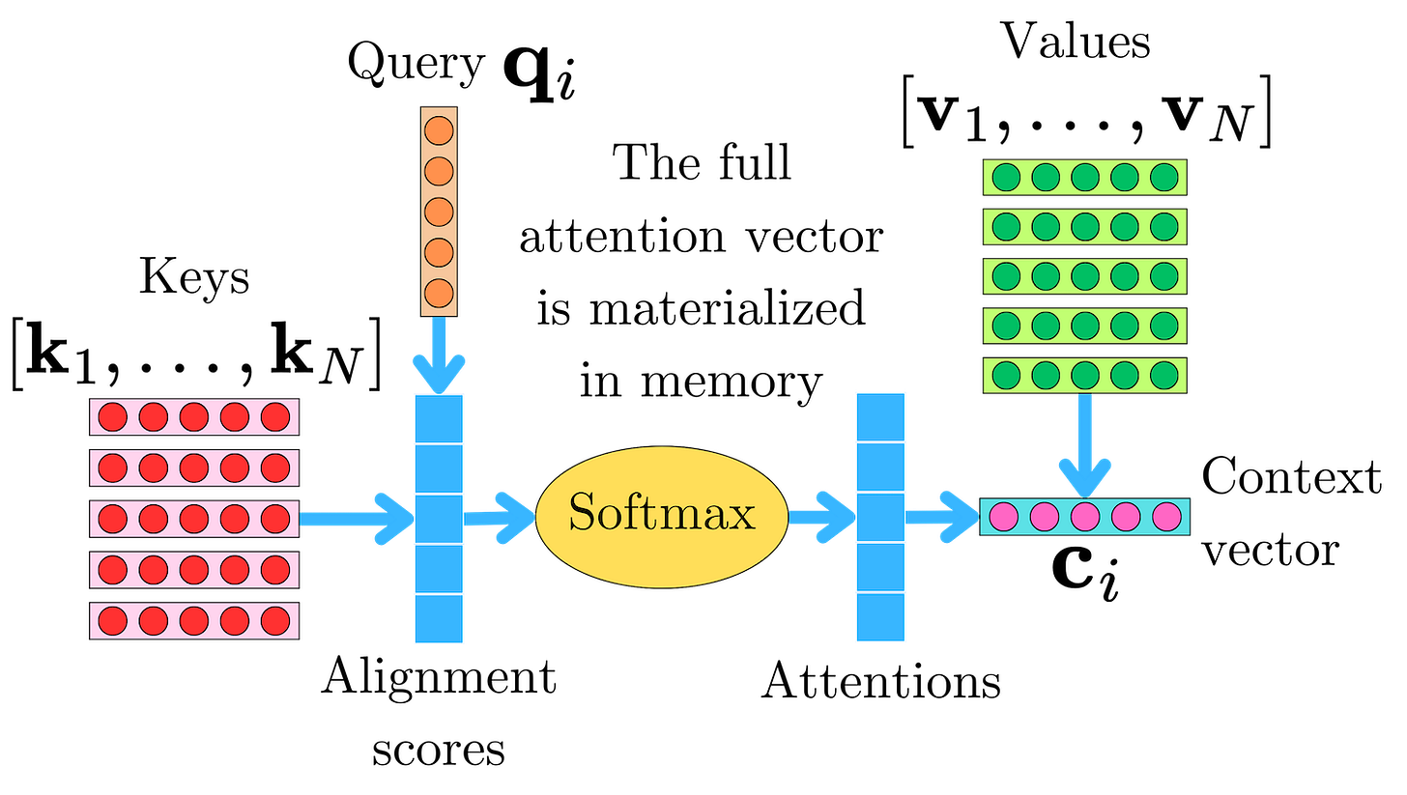
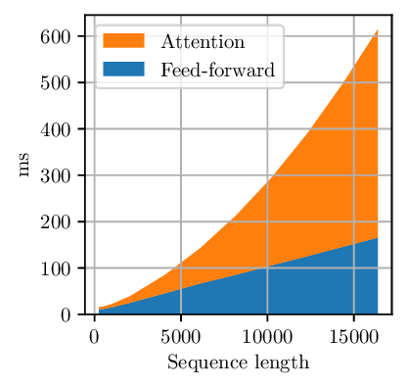
Root Problem of Attention
Excessive HBM Round-trips (Memory-Bound)
Mechanism: Data repeatedly "shuttles" between HBM and SRAM.
The Problem: Standard Attention writes QK to HBM, only to read them back immediately for the Softmax step.
Impact: The system spends more time moving data than actually computing, hitting the "Memory Wall.“
Quadratic Memory Footprint (Memory Capacity)
Mechanism: Intermediate matrices S and P scale at O(n²) complexity.
The Problem: Storing the full Attention Map requires an exponential amount of memory as sequence length increases.
Impact: Doubling the sequence length N results in a 4x increase in memory usage, leading to frequent OOM errors during long-context tasks.

Slide 6
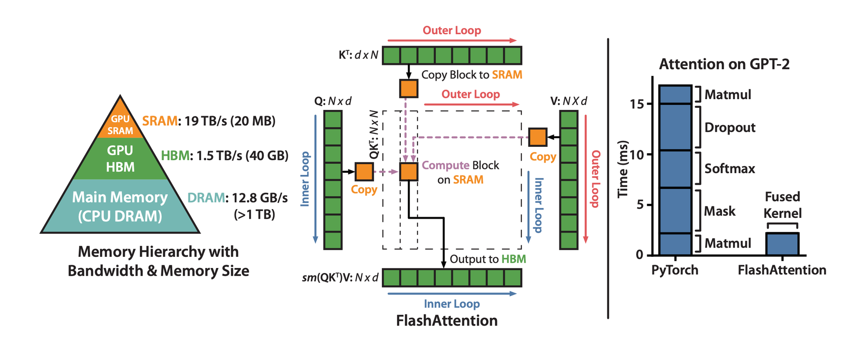
Core Idea of Flash Attention: Less movement
Less Movement, More Speed
Design Philosophy: Optimize Data Movement, Not Just Computation
Two Technical Pillars:
Tiling: Breaking down large tasks into smaller blocks that fit the SRAM capacity.
Recomputation: Instead of storing intermediate activation values during the forward pass, they are recalculated during the backward pass to save memory space.

Slide 7
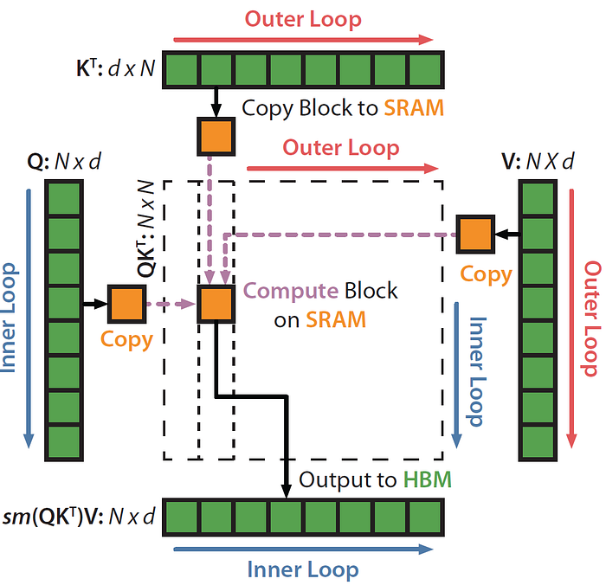
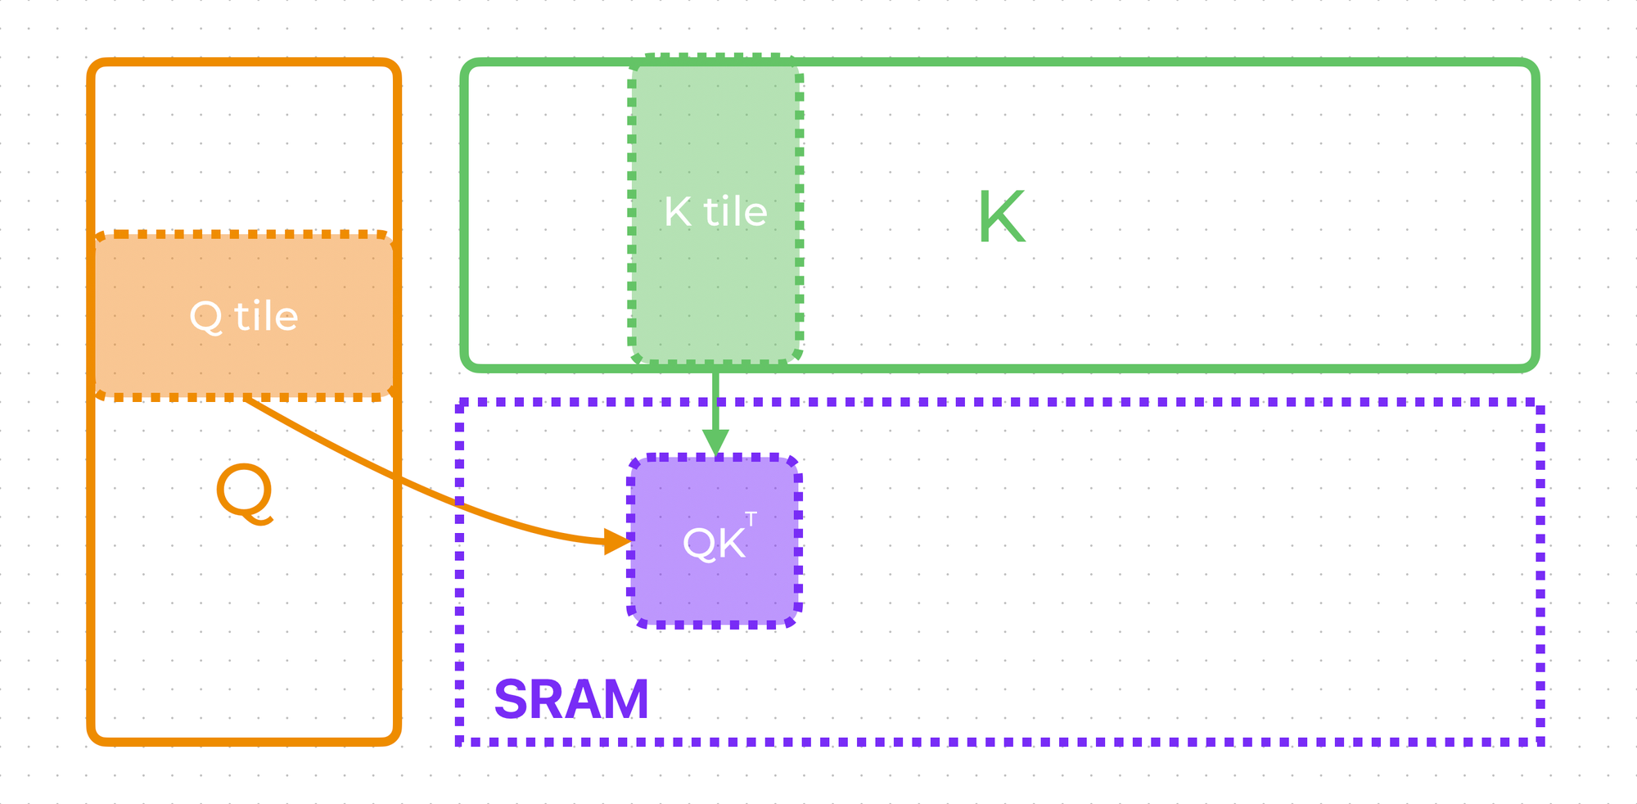
Tiling Concept
Why Tiling?
GPU SRAM (e.g., L1/Shared Memory in A100) is extremely fast but has very limited capacity (typically a few hundred KB).
Traditional N x N matrices (e.g., when N=4096) far exceed SRAM capacity and must be partitioned into "tiles" that can fit into the cache.
How it Works?
Input matrices Q, K, and V are partitioned into blocks (tiles).Using nested loops, these blocks are loaded from HBM to SRAM piece by piece for local computation.
Performance Gain: Partial dot-products and Softmax accumulations are completed entirely within SRAM. This eliminates the need to write N x N intermediate results back to the slow HBM.
Notes:
分块技术 (Tiling)：化整为零的艺术
为什么要分块？
GPU 的 SRAM（如 A100 的 L1/Shared Memory）虽然极快，但容量极小（通常只有几百 KB） 。
传统的 $N \times N$ 矩阵（如 $N=4096$ 时）远超 SRAM 容量，必须将其切成能塞进缓存的小块（Tiles） 。
如何操作？
对输入矩阵 $Q, K, V$ 进行纵向或横向切分 。
通过外层和内层循环，逐块将数据从 HBM 加载到 SRAM 。
计算收益 ：
在 SRAM 内部完成局部点积和部分 Softmax 累加，无需将 $N \times N$ 的中间结果写回缓慢的 HBM 。

Slide 8
Dynamic Demo
The process of loading tiled blocks.

Slide 9
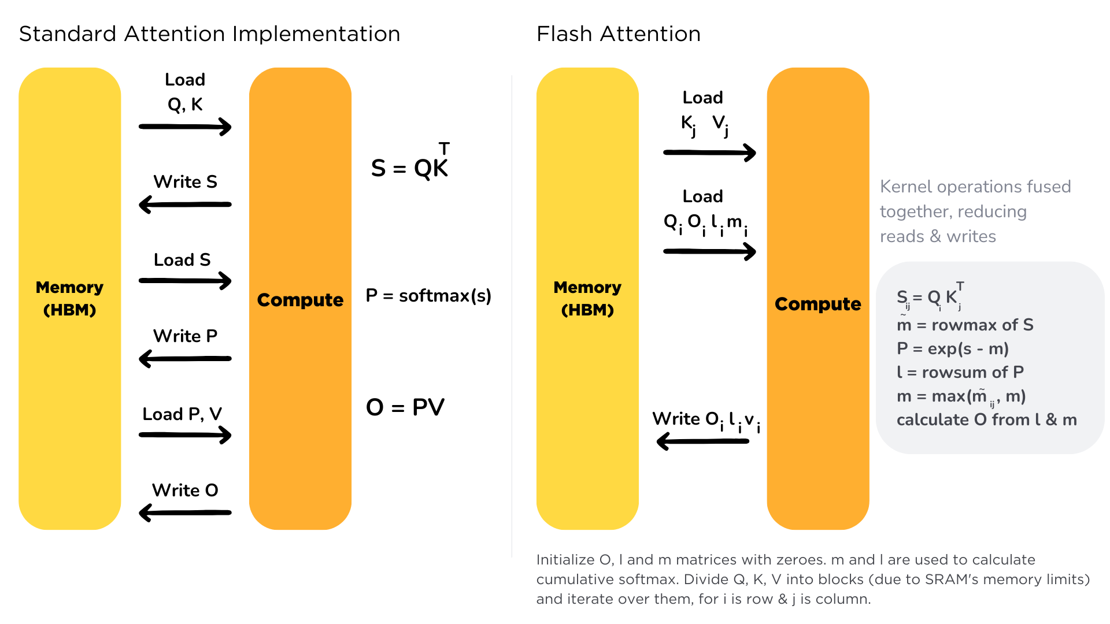
Memory Access Comparison
Standard Attention vs. Flash Attention

Slide 10
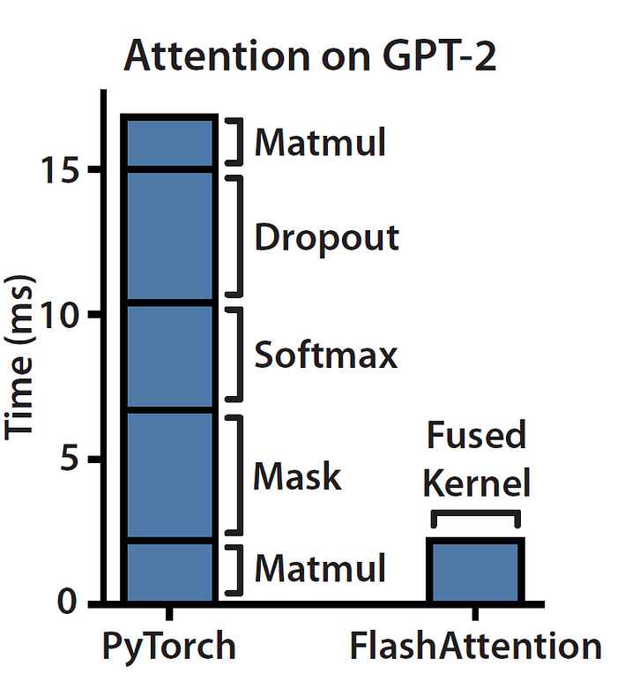
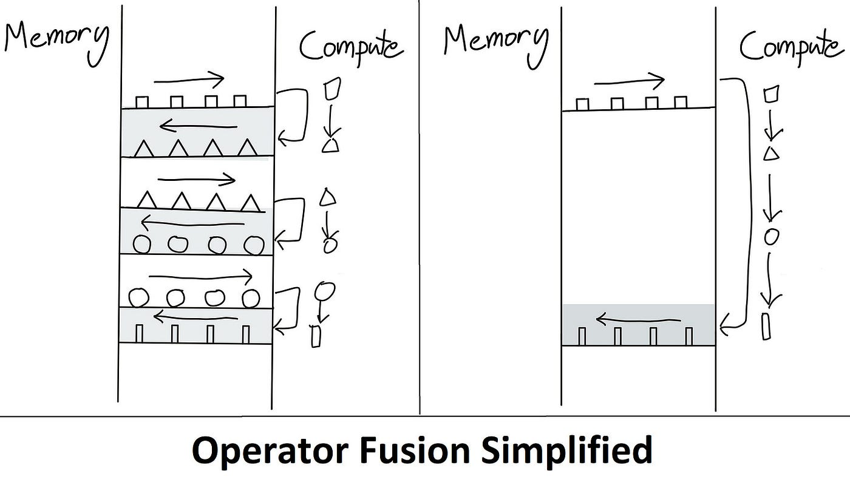
Kernel Fusion
Standard attention launch separate kernels
Each launch clears the SRAM and writes results back to HBM, causing massive I/O waste.
Flash attention fuse all logic into one highly optimized kernel
SRAM-Centric Execution: Perform tiled loading, dot-product, online softmax, and weighted sum within a single loop.

Slide 11
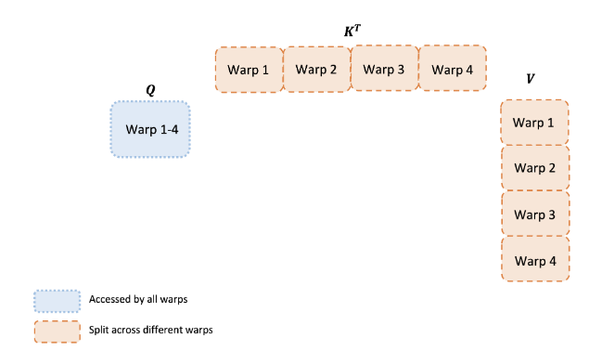
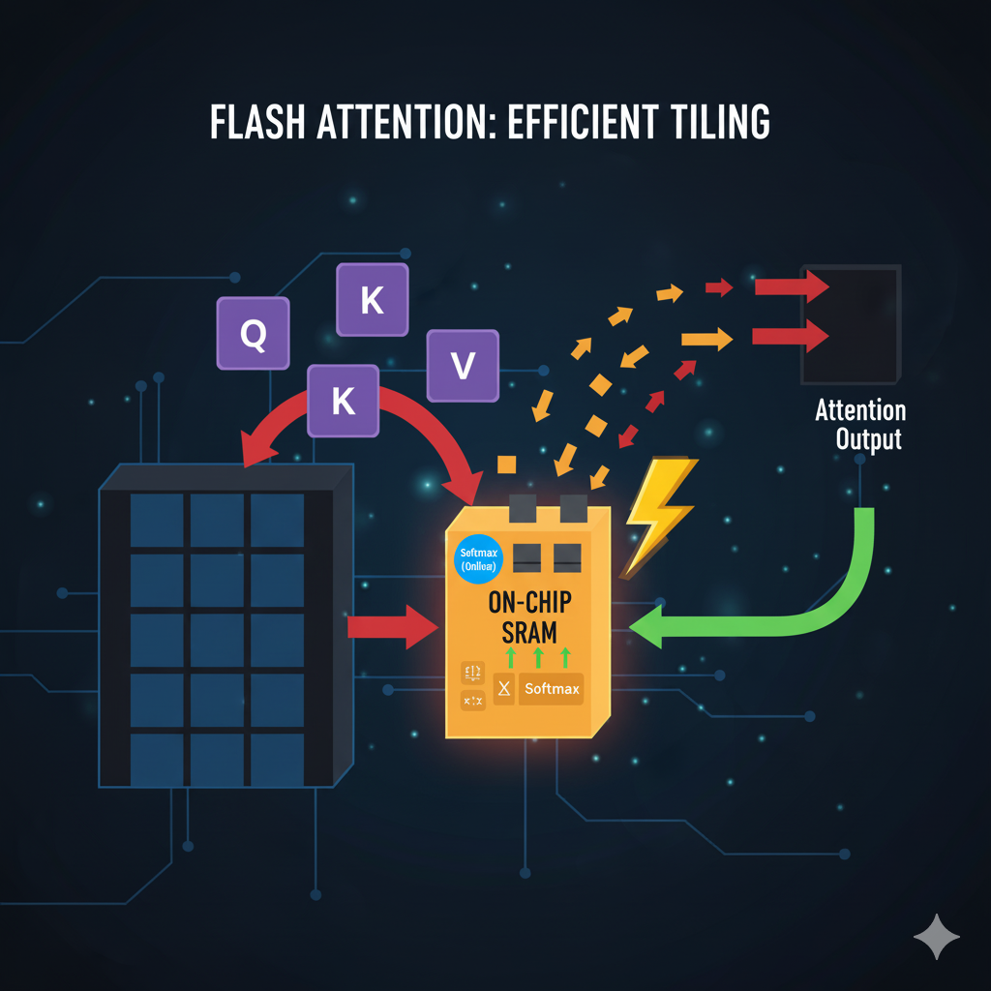
SRAM Scheduling: Tiling & Memory Efficiency
The Scheduling Strategy: Tiling
Partitioning: Q is split by rows; K and V are split by columns.
Dual-Loop Execution:
Outer Loop: Loads a block of K and V into SRAM.
Inner Loop: Loads a block of Q, performs dot products, and updates the output.
The Result: The intermediate Attention Matrix is computed and consumed entirely within SRAM, never touching HBM.

Slide 12
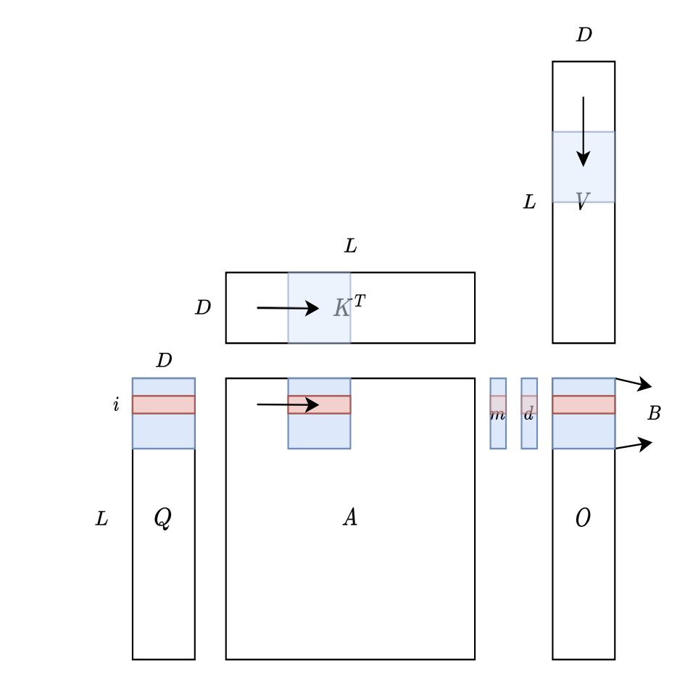
Forward Pass Implementation
How Tiling enables computation without storing the N x N matrix.
Outer Loop (Loop over K, V blocks): Divide K and V matrices into column blocks and load them into SRAM.
Inner Loop (Loop over Q blocks): Divide Q into row blocks. For each Q_{i}, perform the computation.
On-chip Computation: Compute local attention scores in SRAM and immediately apply weighted summation with V.
Write-back: Only the final output matrix O (size N x d) is written back to HBM, completely bypassing the O(n²) intermediate storage.

Slide 13
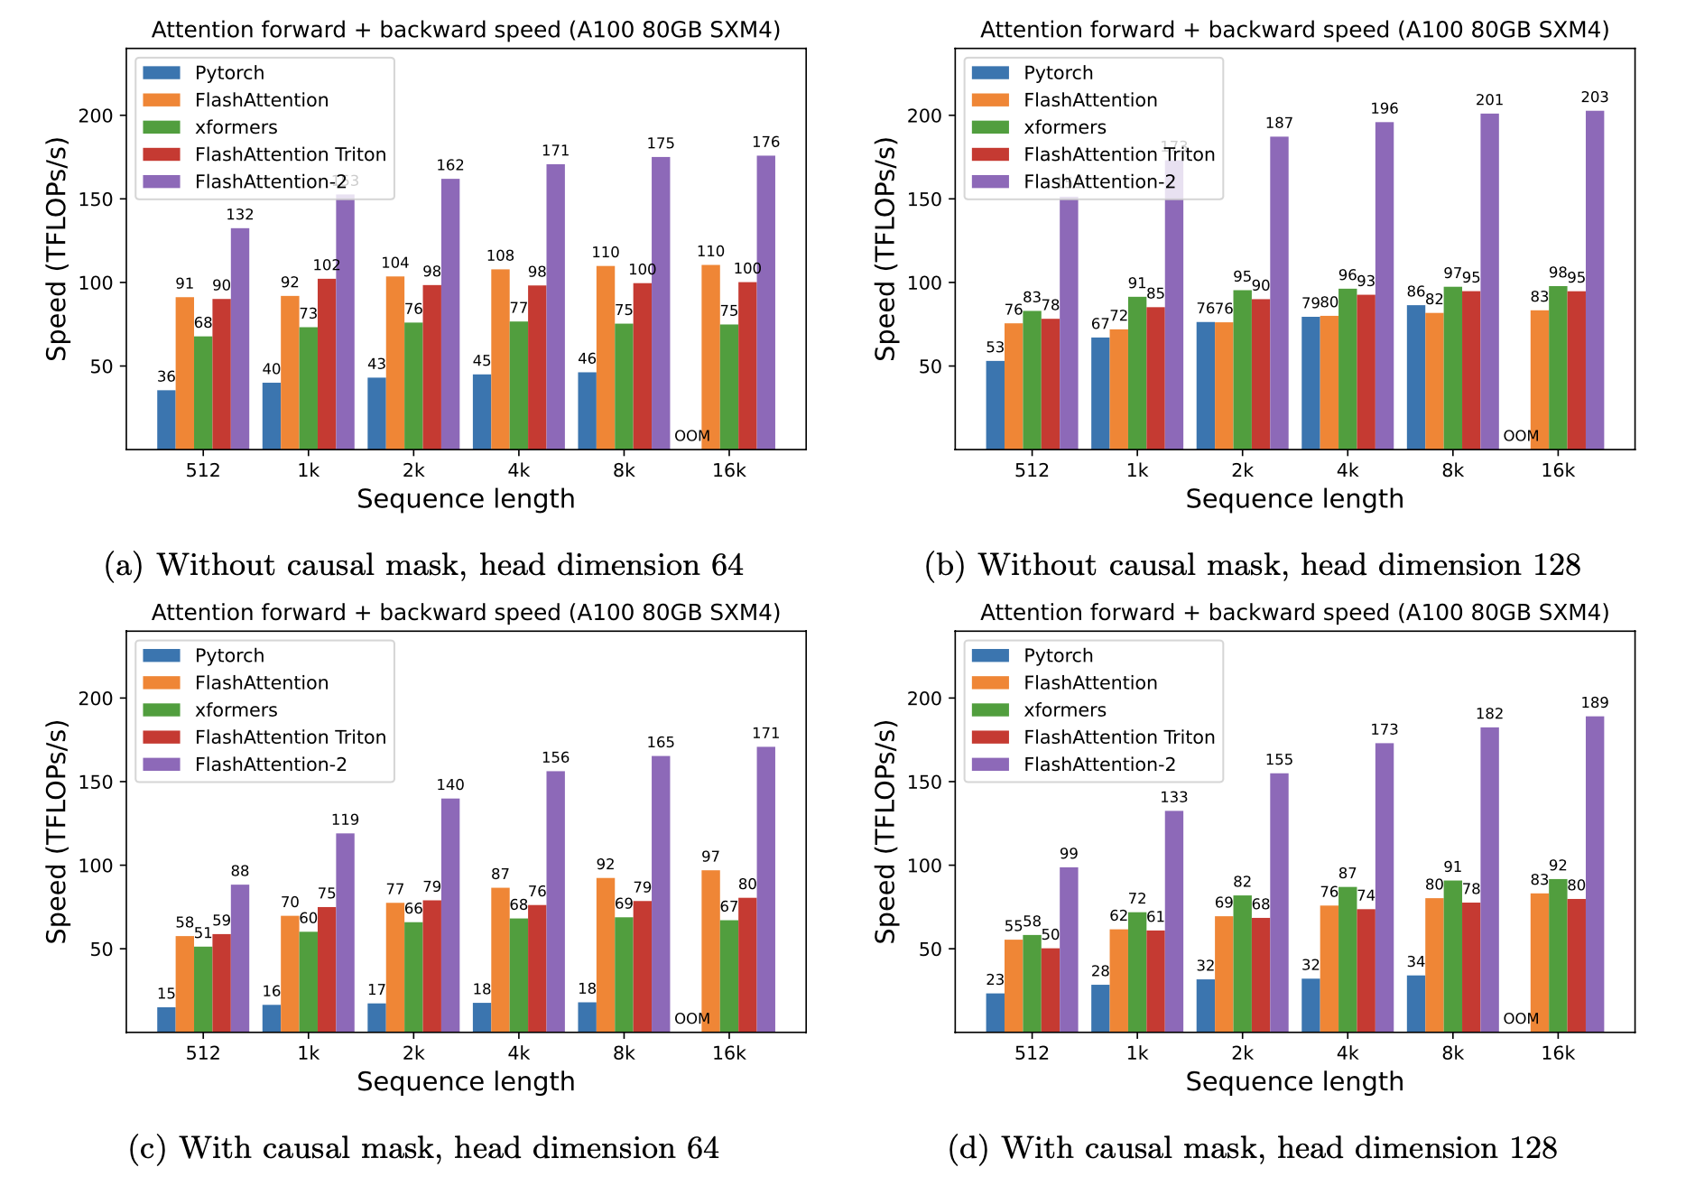
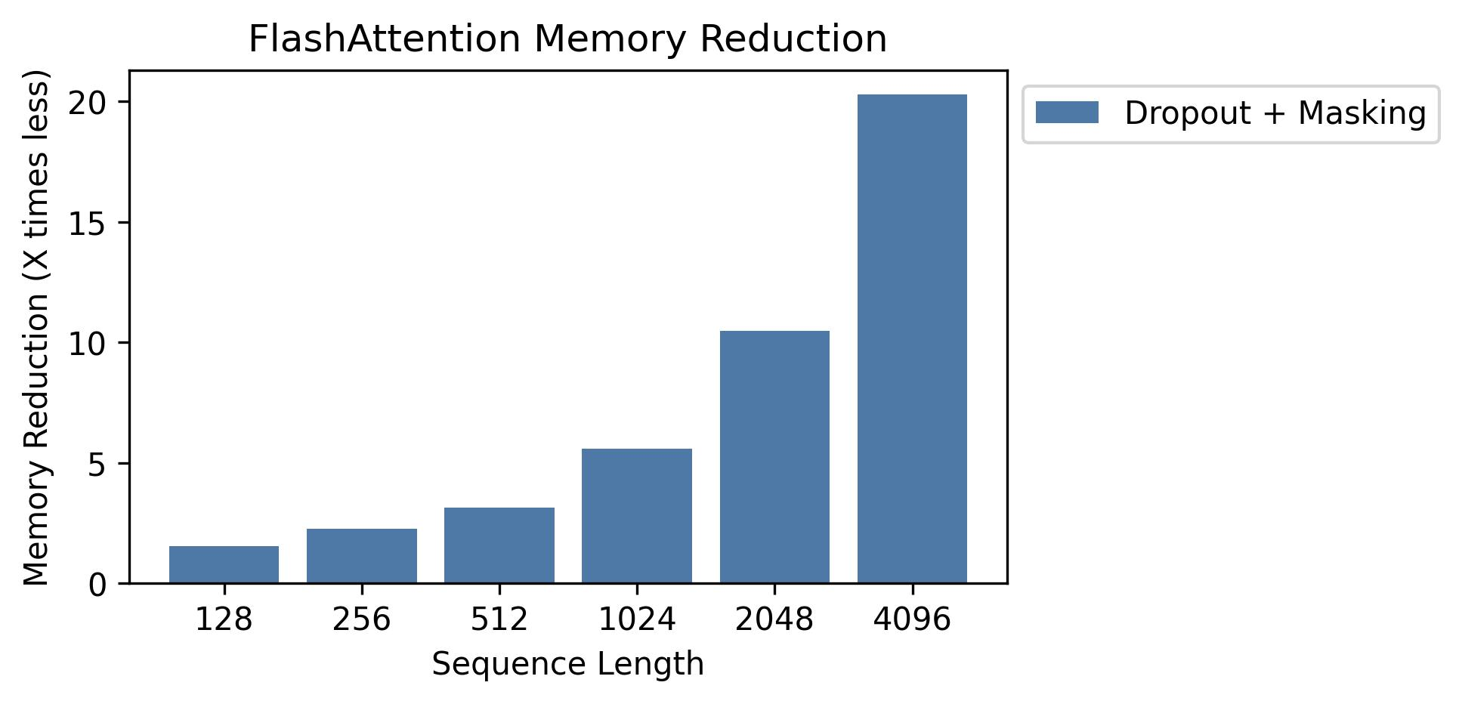
Performance Benchmarks & Throughput

Slide 14
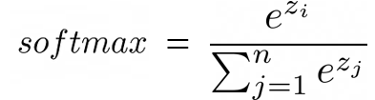
Challenge: The Global Dependency of Softmax
Why can’t we directly compute Softmax on individual blocks?
Problem Description:
Definition:
The Tiling Dilemma: Softmax requires the Global Maximum (m) for numerical stability and the Global Sum (L) for normalization.
The Conflict: When processing the first block, we don't know the maximum value or the sum of the remaining blocks. Standard logic suggests we must scan the entire row first.
Transition Question: How can we compute or "predict" the correct Softmax output while only seeing a partial chunk of data?
Notes:
单击此处添加文本

Slide 15
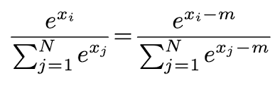
Review of Safe Softmax
The Necessity of Safe Softmax
Preventing numerical overflow by subtracting the maximum value.
Overflow Risk: Direct calculation of e^{xi} can lead to numerical overflow (Floating Point Overflow) when x_{i} is large (e.g., x_{i} = 1000).
Solution: Subtract the maximum value m = max(x_{i}) from each element in the vector before exponentiation.

Slide 16
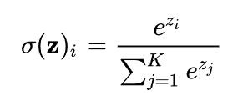
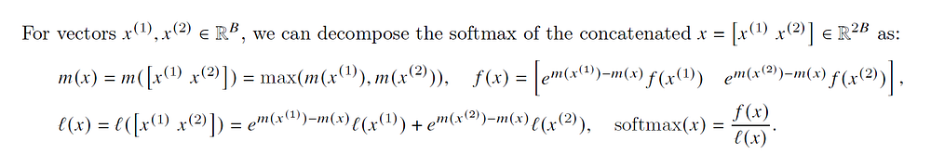



Online Softmax Algorithm
Online Softmax
Example
S = [x₀​, x₁​ ,x₂ ​,x₃​], V=[v₀​, v₁, v₂ ​,v₃​]
Milakov, Maxim, and Natalia Gimelshein. "Online normalizer calculation for softmax." arXiv preprint arXiv:1805.02867 (2018).
Notes:
基于观察，避免在 HBM 中读写注意力矩阵对于提升注意力机制的时钟速度至关重要。为了减少读写操作，FA通过 Tiling分块执行 softmax 约简（因为读写完整的注意力矩阵非常耗费资源），通过重新计算避免存储用于反向传播的大型中间注意力矩阵
实现 tiling 方法的主要障碍是 softmax。具体来说，softmax 将所有得分列耦合在一起。以下是计算 softmax 第 i 个输出的方法。z_i 是第 i 个得分（键-查询点积），输出是第 i 个 token 的概率，我们稍后会用它来加权值向量（再次强调，我假设你知道注意力机制）。看到分母了吗？这就是问题所在。要计算输入序列中第 i 个 token 对序列中其他 token 的关注程度，你需要在 SRAM 中准备好所有这些得分（这里用 z_j 表示）。但需要提醒的是：SRAM 的容量非常有限。你无法加载所有 token。N（序列长度）可以是 1000 个，甚至 100,000 个 token。因此，N² 会迅速膨胀。
所以，诀窍就在这里：我们可以将 softmax 计算拆分成更小的块，最终仍然得到完全相同的结果。主要公式如下：1. softmax 的部分计算（我们将迭代计算得到正确的 softmax 值）。我们可以只取前 B 个分数（x_1 到 x_B），并计算它们的 softmax 值。这些数字至少目前是错误的。但请耐心等待，通过迭代，我们将“收敛”到正确的结果。m(x)的目的仅仅是为了避免数值不稳定性

Slide 17
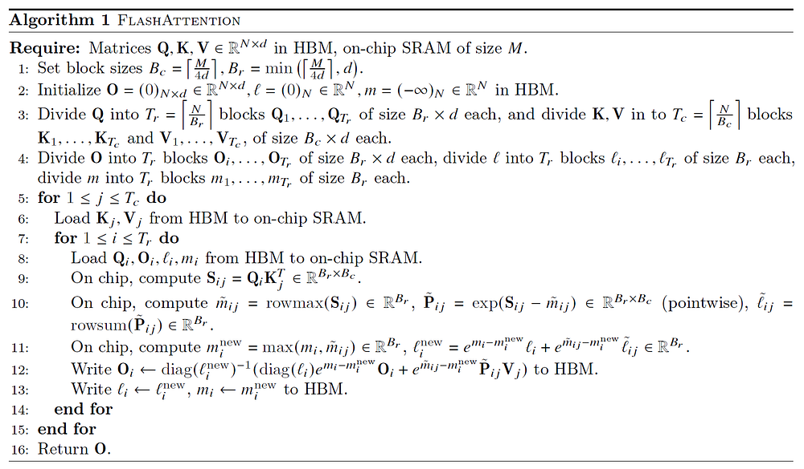
Formula Derivation
Notes:
步骤 1：计算行/列块大小。为什么是 ceil(M/4d)？因为查询、键和值向量都是 d 维的，我们还需要将它们组合成输出的 d 维向量。因此，这个大小基本上允许我们用 q、k、v 和 o 向量最大化 SRAM 容量。至于 B_r，我不太清楚他们为什么要对 d 进行取最小值操作We don't want B_r to be larger than d since we want B_c * B_r <= M / 4 (we store a few matrices of size B_c * B_r on SRAM). 为了保证 Q 块的行数不会超过其 头维度 d 太多，从而优化 矩阵乘法 (MatMul) 的效率
步骤 2：我们将输出矩阵 O 初始化为全 0。它将充当累加器，因此该值为初始值。m（记住：它的目的是保存 softmax 的累积分母——exp 分数之和）也初始化为 -inf，因为我们将对其进行最大值运算，所以无论第一个块的最大值是多少——它肯定大于 -inf——因此这是自然的初始值。步骤 3：我们使用步骤 1 中的块大小将 Q、K 和 V 拆分成块。另见上图。步骤 4：同样地，将 O、l、m 拆分成块（块大小与 Q 相同）。步骤 5：让我们开始跨列循环，即跨键/值向量循环（上图中的外层循环）。 步骤 6: 让我们将 K_j 和 V_j 块从 HBM 加载到 SRAM 中。记住，由于我们构建块大小的方式，目前仍有 50% 的 SRAM 空间未被占用（专用于 Q 和 O）。步骤 7：开始跨行（即跨查询向量）的内循环。步骤 8：将 Q_i (B_r x d) 和 O_i (B_r x d) 块以及 l_i (B_r) 和 m_i (B_r) 加载到 SRAM 中。当我们计算块大小时，只够容纳 K_j、V_j、Q_i 和 O_i，那么 l_i 和 m_i 如何放入 SRAM（包括所有中间变量）中呢？寄存器
步骤 9及之后的就是我们刚刚提到的计算过程了

Slide 18

The Solution: FlagOS, a Unified AI Software Stack

Slide 19








https://space.bilibili.com/3546791834290849
https://github.com/flagos-ai
https://www.zhihu.com/people/95-22-20-18/posts
https://flagos.io/Home

Slide 20
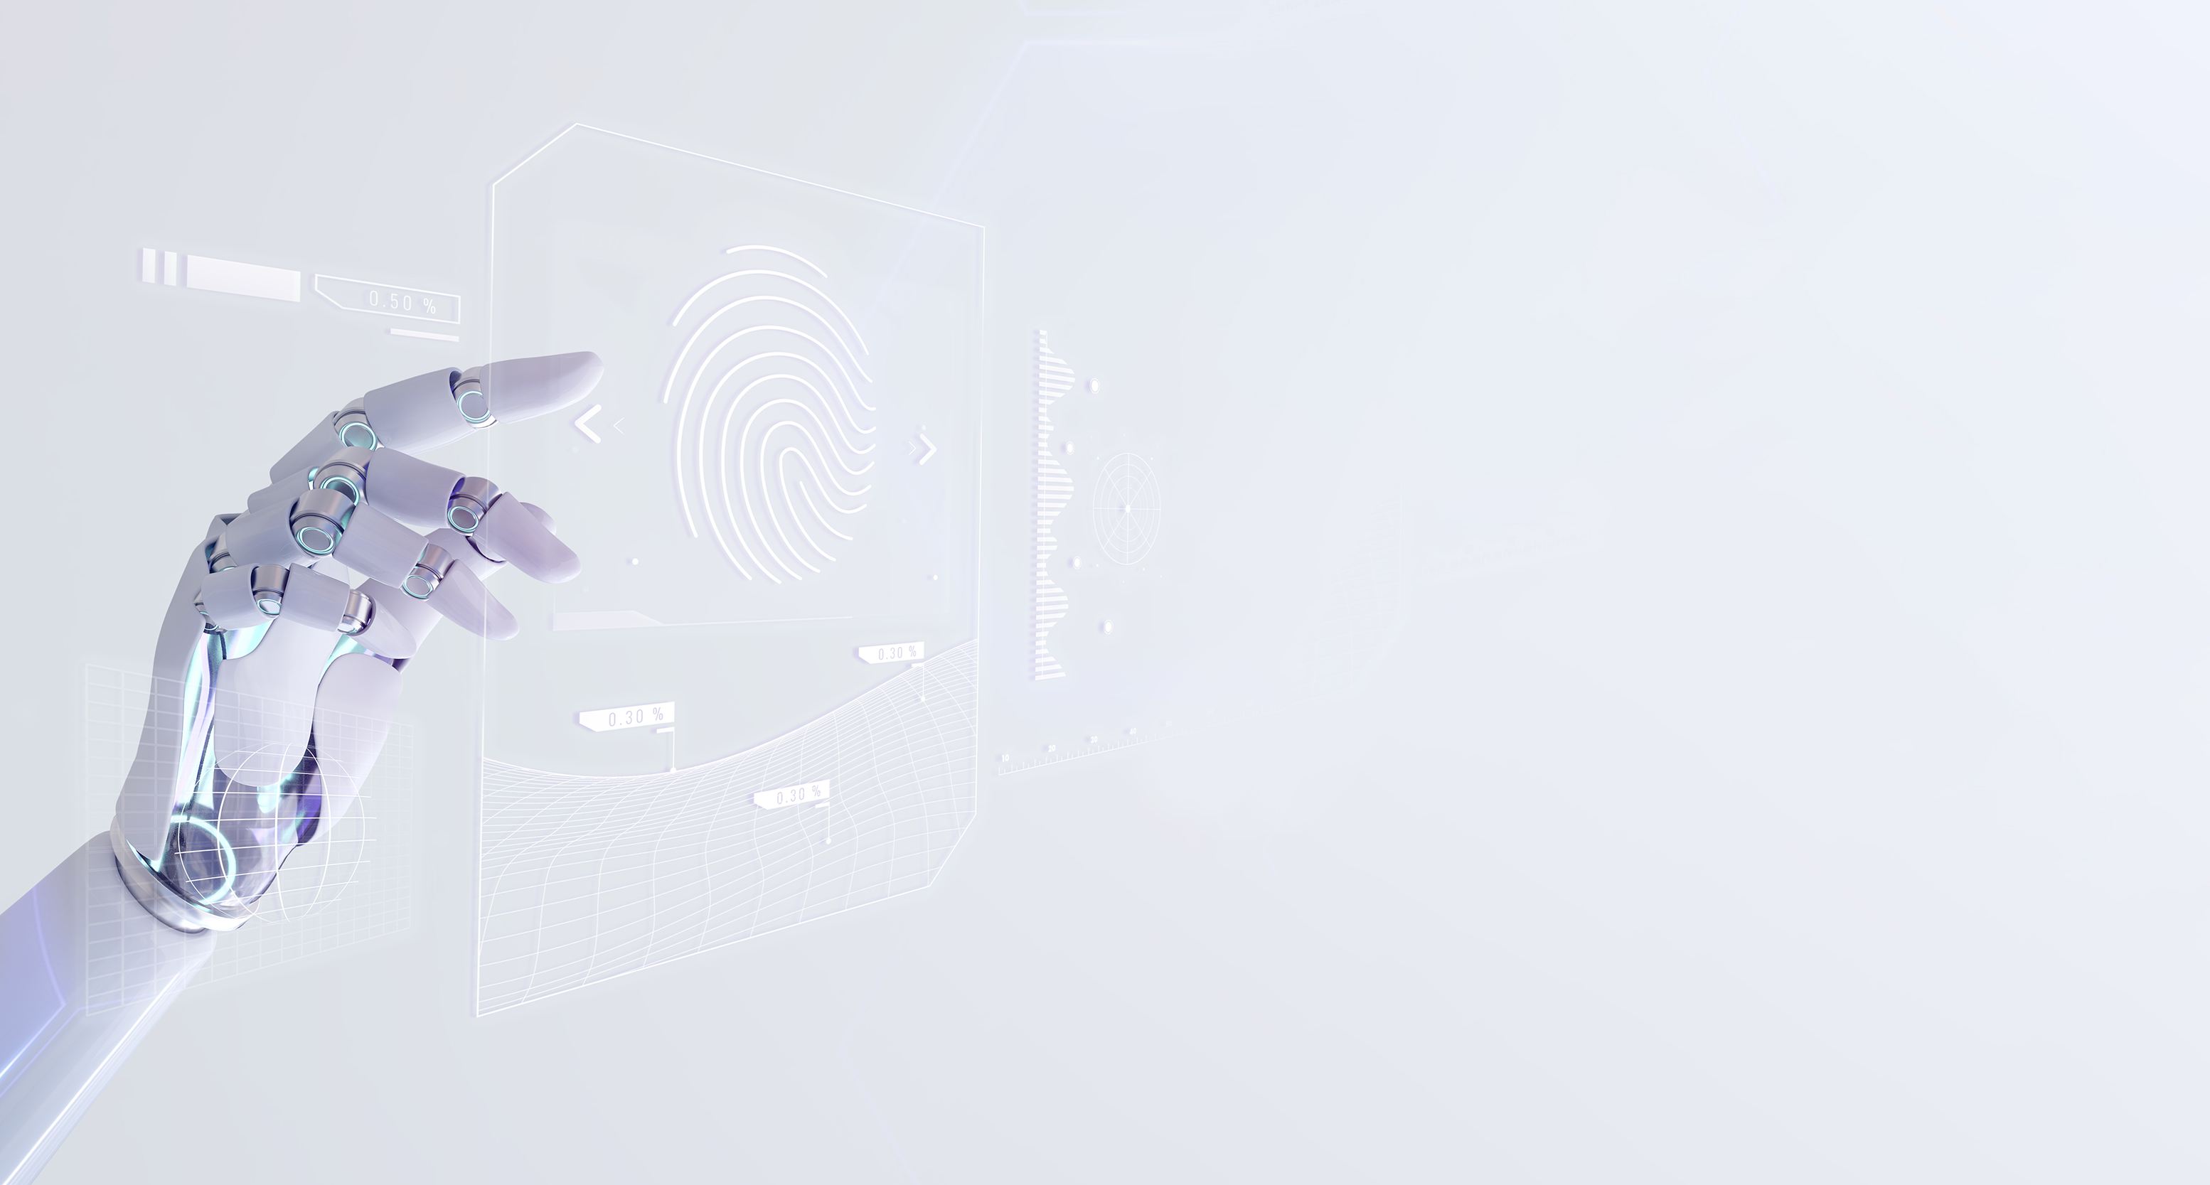
Thanks for your time！

